Slide 1
Madden 18
JeDarrik (J.D.) McGhee

Slide 2


Who I am
My name is JeDarrik McGhee which I am better known as for J.D.. I was born and raised in Atlanta, GA. I am also a graduate student who is looking for an opportunity to help organizations achieve their business goals. I have a BBA and MBA. I love and enjoy hiking, sports, traveling, and spending time with family.

Slide 3
Football Fanatic
I have been around football for 20 years. I have played football throughout my High School and College days. I am a huge fan of Auburn University and love NFL. I follow this sport all year around and never missed a day. As EA Sports, I have a been a Madden player for 15 years. I am a huge fan of Madden franchise and want to help this franchise succeed in the future.

Slide 4
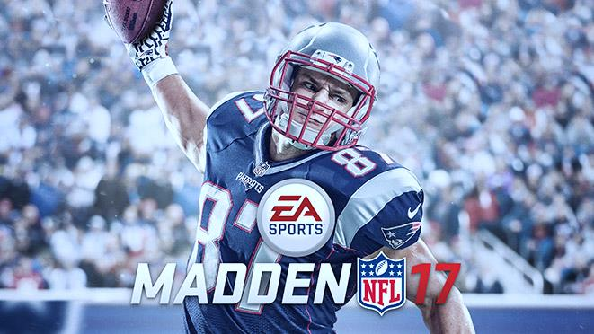
Madden 17
EA Sports have done a wonderful job for Madden 17. This is the best Madden that EA Sports produce in the last 5 years. We love the new commentary which is something that we have been waiting on for a very long time.
Also, the amination have improved with the new gears and uniforms which make players look just like themselves during game day. Thank you so much for also having players gear color actually matching throwback and color rush uniforms. Madden 17 have improved a lot!!! Please, DO NOT take away any new features for this Madden franchise.
However, I have few suggestions that I have notice during my gameplay with Madden 17 and have great ideas for this season or next year Madden.

Slide 5
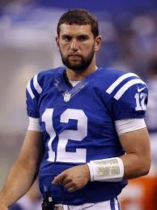
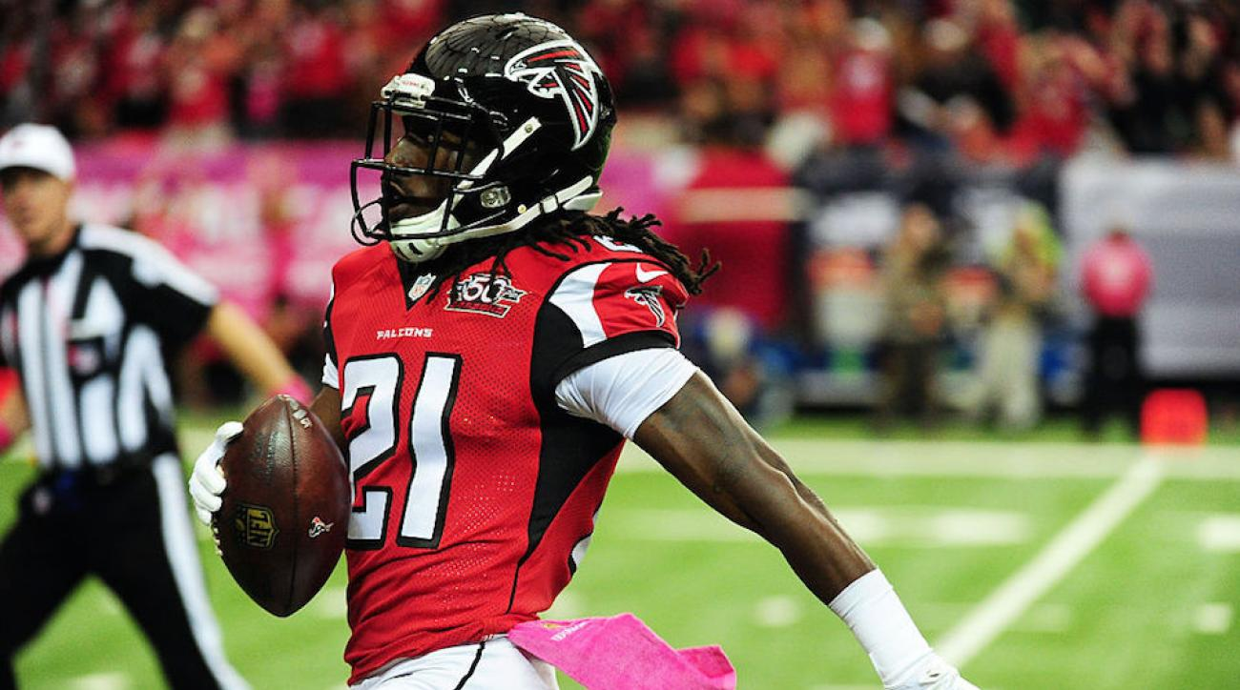
Improve: ¾ Sleeves
¾ sleeves are getting popular in the NFL. ¾ sleeves were additionally added in NCAA Football 2014. ¾ Sleeves are sleeves that only cover half biceps. An under armor T-Shirt is a great example. A few NFL players are actually wearing ¾ sleeves during game day.

Slide 6
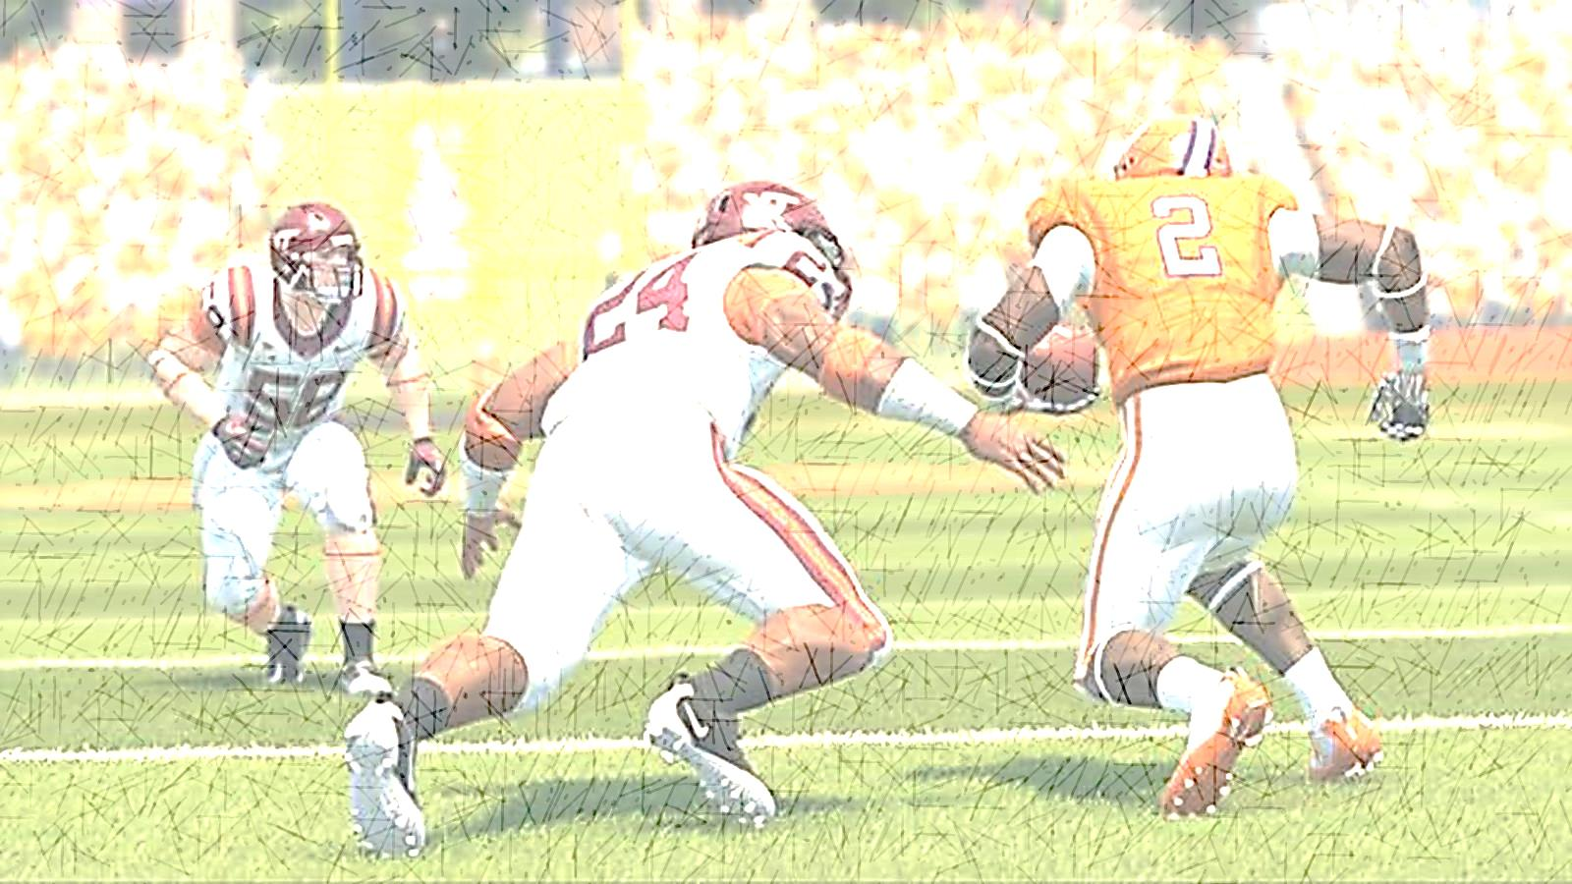
NCAA FOOTBALL 14
During this franchise, EA Sports have added ¾ sleeves and succeed. Here is an example of a ¾ sleeves.

Slide 7
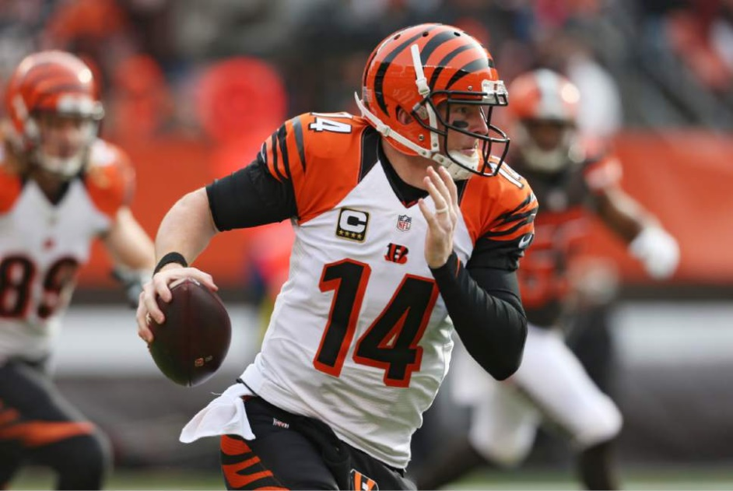
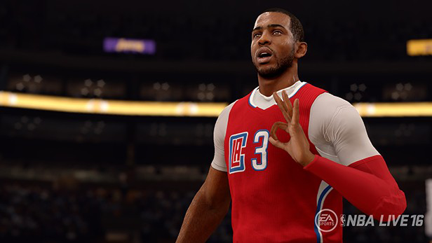
Is this hard to create these gears for Madden?
No! Again, If EA Sports took their time to create these gears perfection in NBA Live, why not Madden?
. ☺

Slide 8
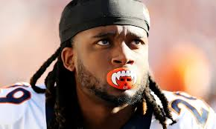
Mouth Piece
Mouthpiece is getting popular in the NFL. Players are wearing unique mouthpiece such as this example.

Slide 9
Improve: Team Auto Color Gear
Team Auto Color Gear is extremely important to make animation players look realistic. Team Auto Color Gear is a color option that players gear will match any color uniform (Jerseys).
For example, Cam Newton and Carolina Panthers players are wearing black (Sleeves and Sweatbands) with home uniforms and white (Sleeves and Sweatbands) with away uniforms. New York Giants players are wearing blue (Sleeves and Sweatbands) with their home uniforms and white (Sleeves and Sweatbands) with their away uniforms. Another great example for teams is Oakland Raiders, Detroit Lions, and L.A. Rams.

Slide 10
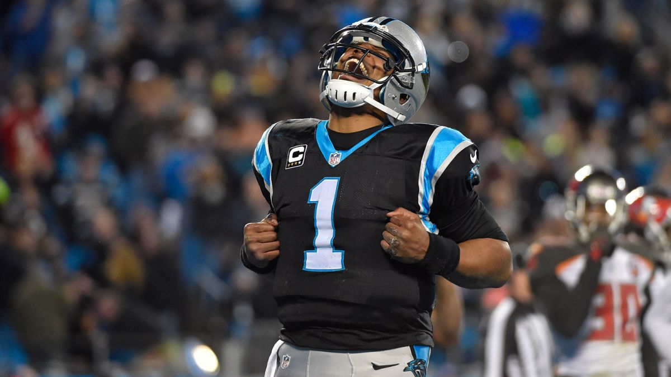
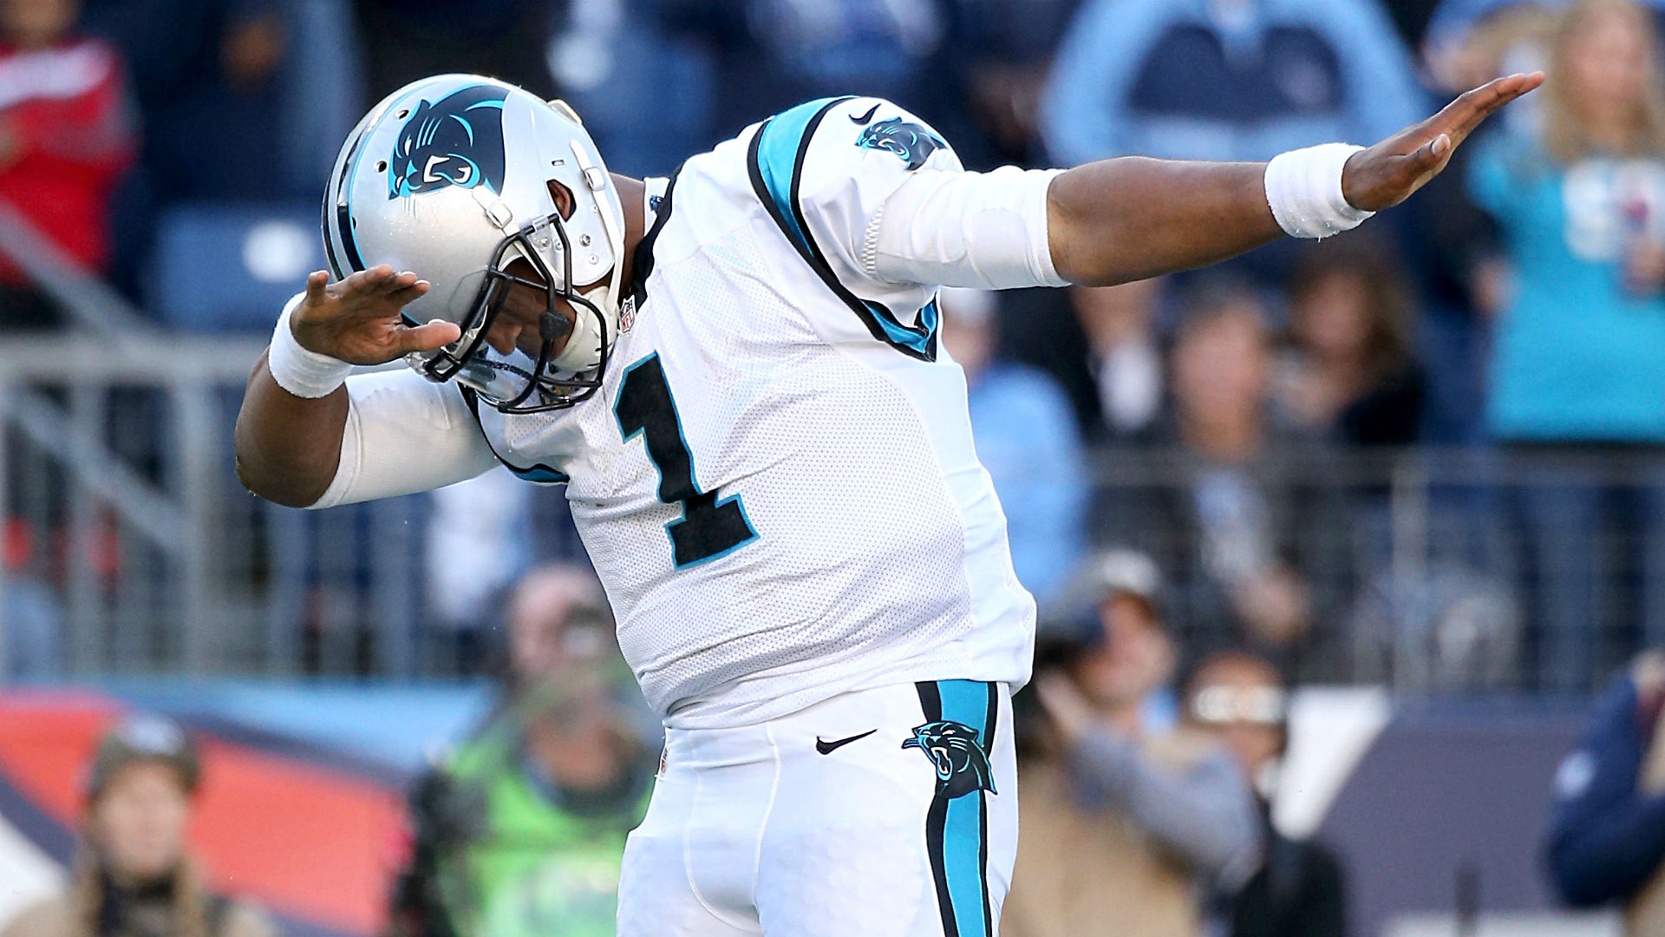
Example: Carolina Panthers

Slide 11
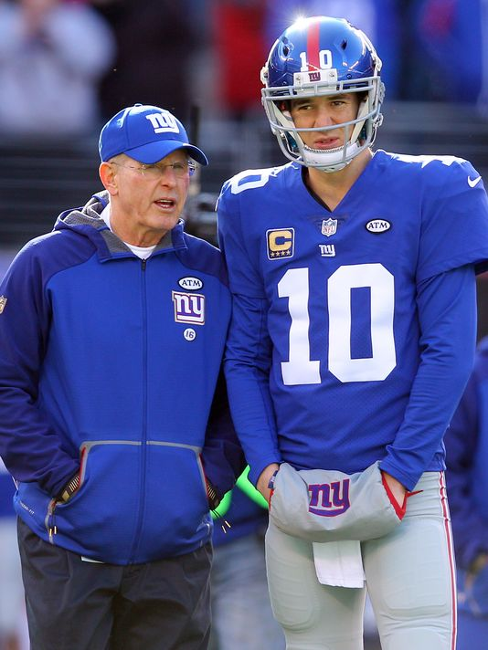
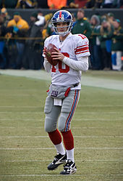
Example: New York Giants

Slide 12
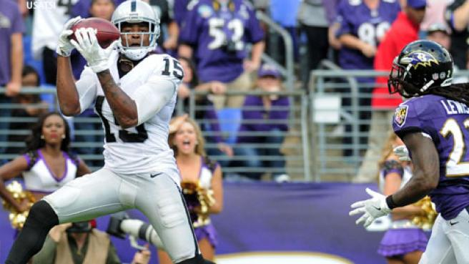
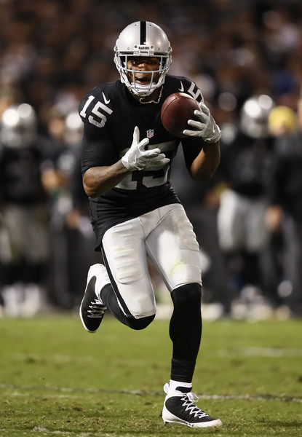
Oakland Raiders

Slide 13
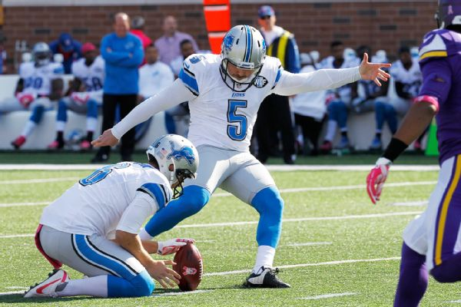
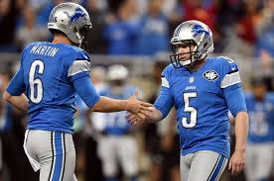
GREAT EXAMPLE: Detroit Lions

Slide 14
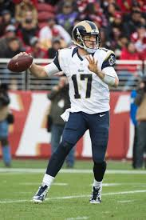
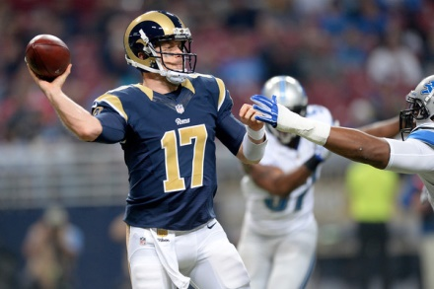
L.A. Rams

Slide 15
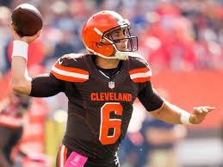
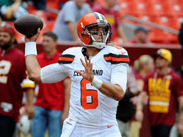
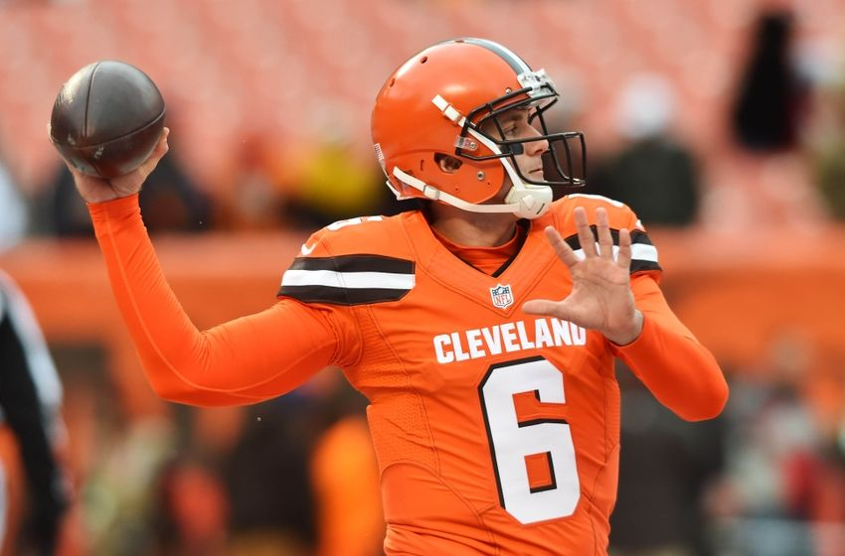
Conclusion
This will make Madden realistic. Here’s a great example of Cleveland Browns QB Cody Kessler. This player wears color sleeves depending on Cleveland Browns uniform (Jersey). This can make gamers excited when they are playing Career Mode and have their create-player swag out with this new feature (Team Color Auto Gear). Please, also add Secondary color under arm sleeves option.

Slide 16
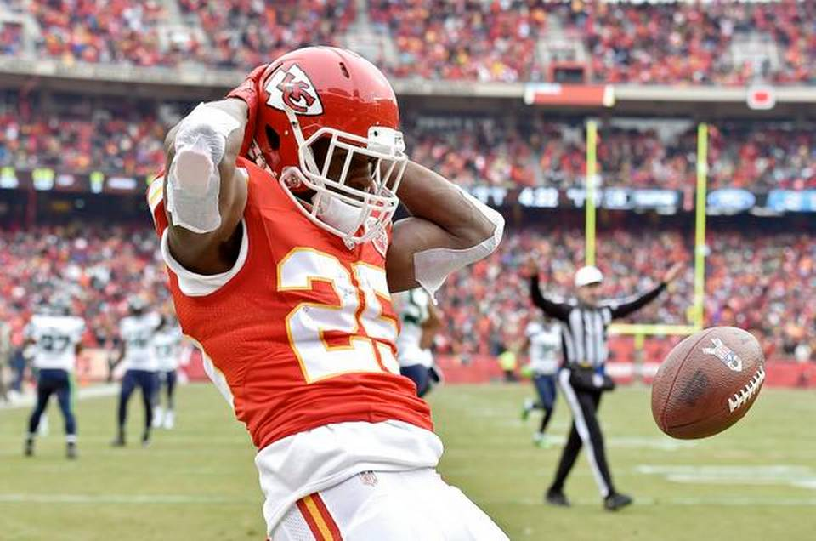
Improve: Turf Tape
Players are actually wearing turf tape during game day due to conditioning of football fields.

Slide 17
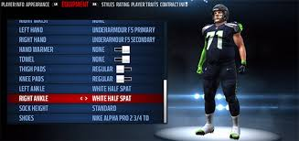
Equip gears for Home and Away uniforms under create and players editing
Over the years, Madden only have players editing or create players gear default to teams home uniform. In the NFL, we see big name players swag their gear depending on their uniforms. We see NBA 2K and NBA Live franchise which gamers can edit their players gear for their home and away uniform.

Slide 18
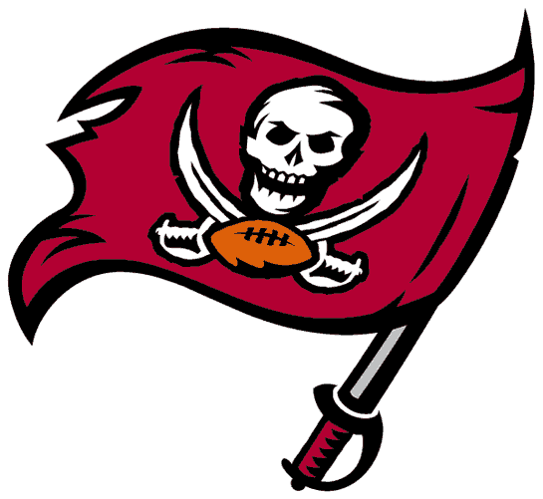
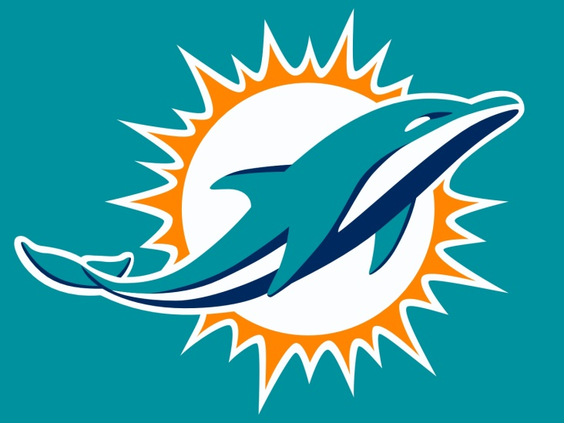
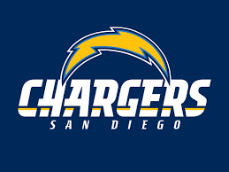
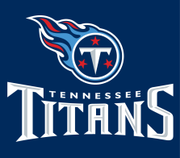
Improve: Tertiary Colors
There are four teams that have tertiary colors which are Miami Dolphins, Tampa Bay Buccaneers, Tennessee Titans, and San Diego Chargers. Each of these team players has five different color gears, not four.

